Slide 1
A Federated Learning Approach for Investigating the Relationship between COVID-19 and Neurological Manifestations
Meghan R. Hutch (Luo Lab)
February 23, 2023

Slide 2
Introductions
4th year PhD Candidate in the Driskill Graduate Program (DGP)
Biomedical informatics track (similar course sequence/structure as HSIP)
Winter 2020 - Student
Winter 2022 - TA
Winter 2023 – Guest lecturer
April 2020 - Began rotating in the Luo Lab and officially joined in July 2020
Thesis focused on evaluating longitudinal EHR data of patients with neurological illnesses (e.g. COVID + Neurological manifestations, traumatic brain injuries)
Member of the 4CE COVID-19 Consortium

Slide 3
Lecture Outline
Part I
Federated Learning
4CE COVID-19 Consortium
Part II
4CE federated study to evaluate COVID-19 and neurological manifestations

Slide 4
Objectives
Recognize the utility of federated learning for EHR research
Review a federated learning pipeline for analyzing data from the 4CE multinational COVID-19 consortium
Introduce the use of a random-effects meta-analysis for a federated learning study

Slide 5
Part I
Introduction to Federated Learning & the 4CE COVID-19 Consortium

Slide 6
Federated Learning
Federated learning is a research methodology that develops a model through a decentralized approach
In a federated learning approach, data is not shared between institutions
Rather, individual models are trained locally at each institution
During & post training, model parameters and results are aggregated (parameters averaged) into a central model – this can be an iterative process
Many ways to conducted federated learning

Slide 7
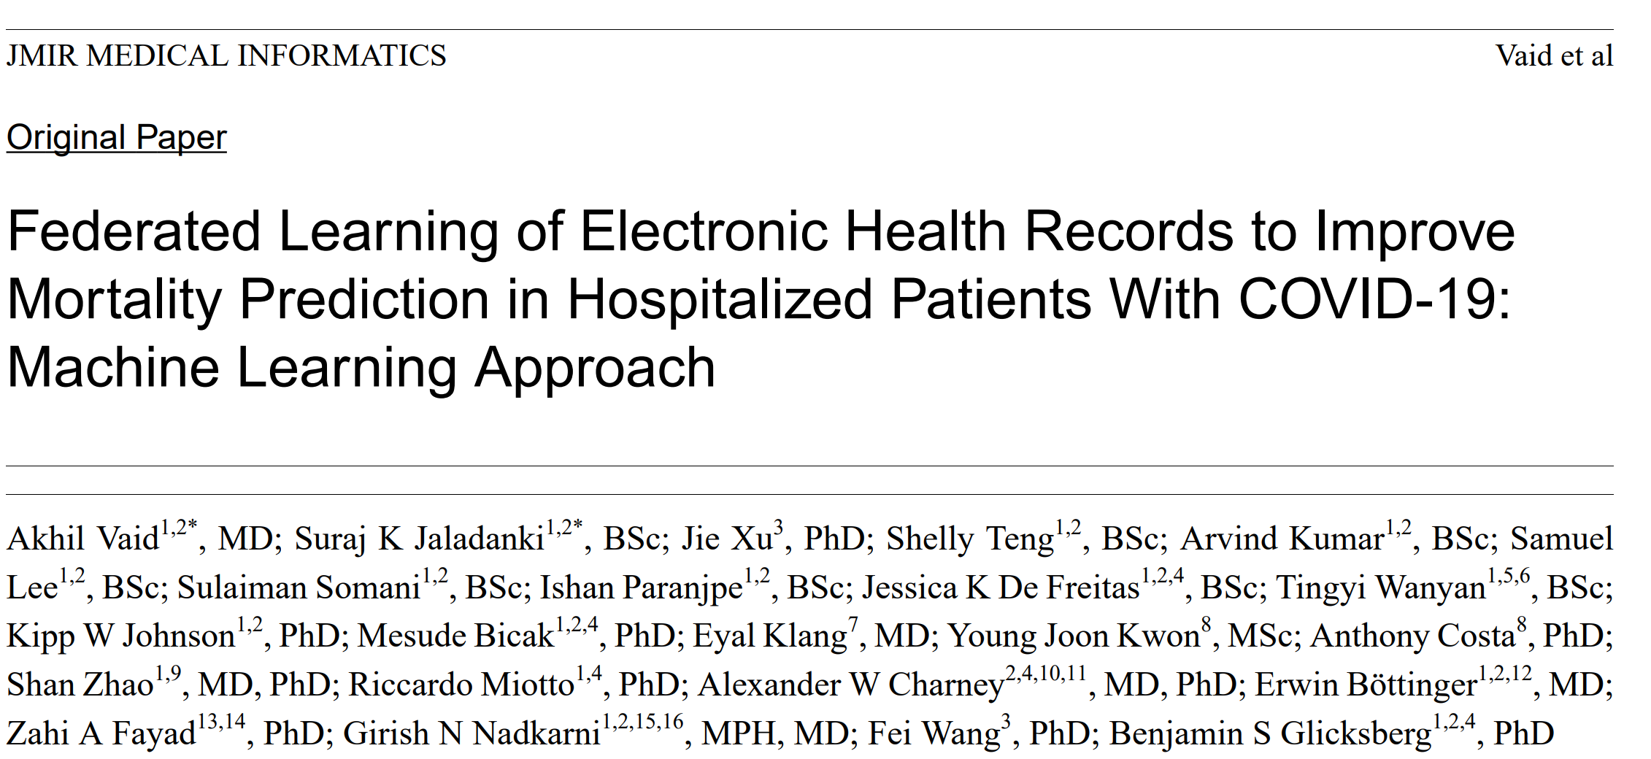
Federated Learning (Vaid et al.)

Slide 8
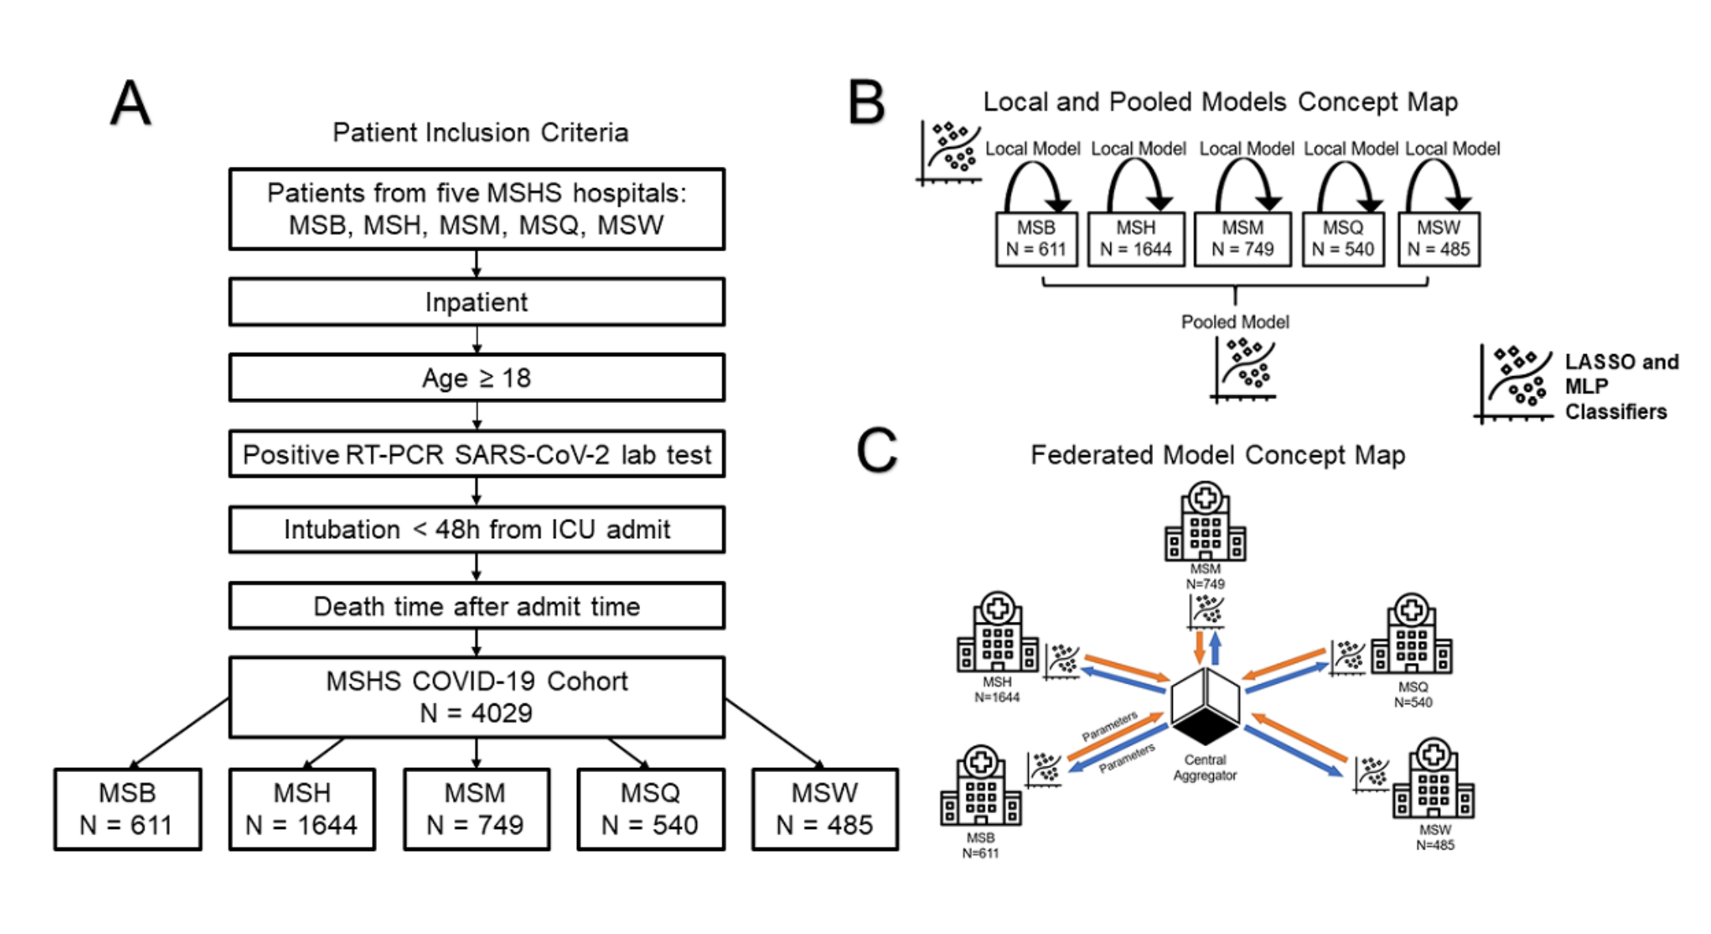
Federated Learning (Vaid et al.)
Notes:
5 Mount Sinai Health System Hospitals
Models (logistic-regression and multilayer perceptron) were first trained locally at each hospital
Parameters from the local models were sent to a central aggregator
As local models trained, model parameters were sent back to the central aggregator which updated parameters and sent them back to each healthcare system
Study evaluated mortality prediction among the local models, the federated models, and a model trained on pooled dataset (data were pooled together from all healthcare systems)
Note from paper: “Federated averaging scales the parameters of each site according to the number of available data points and sums all parameters by layer. Through this technique, federated models did not receive any raw data.”

Slide 9
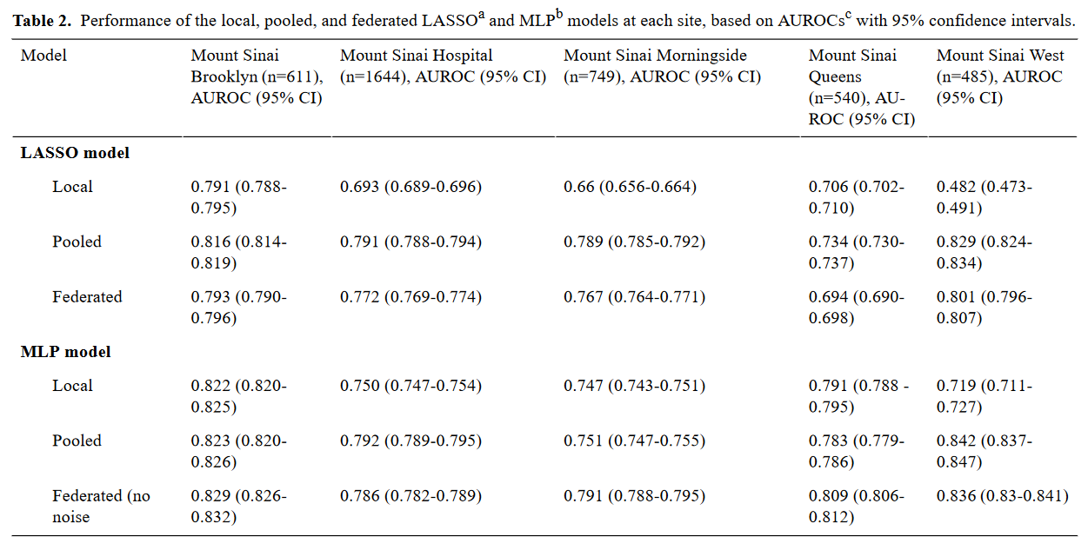
Federated Learning (Vaid et al.)

Slide 10
4CE Approach to Federated Learning
….and what is the 4CE?!

Slide 11
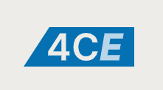
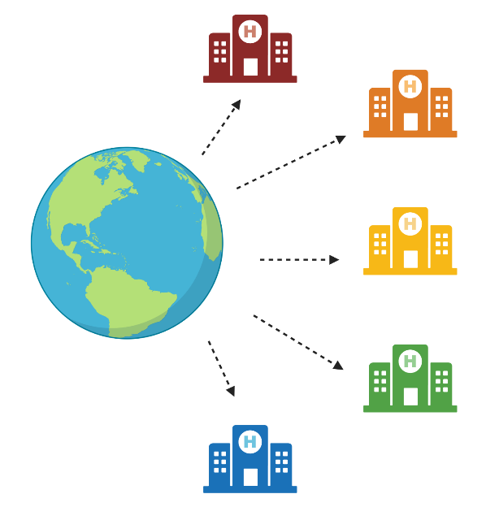
4CE: Consortium for Clinical Characterization of COVID-19 by EHR
4CE is a multinational effort to study COVID-19
Federated effort designed to rapidly leverage data from multiple healthcare systems
351 hospitals and 43 healthcare systems
Participating healthcare systems map electronic health records (EHR) to a common data model
In the 4CE model, patient level data does not leave the institution

Slide 12
What kind of data and how do we get it?

Slide 13
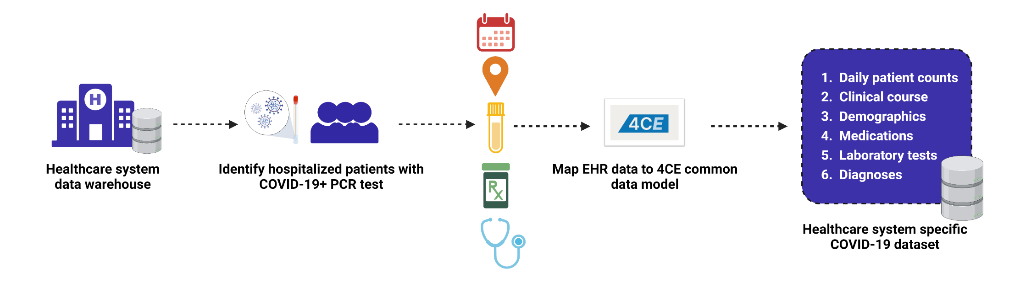
Data Pre-Processing Pipeline: Common Data Model
White blood cell counts
WBC
WBC – lab test
White blood cell counts
White blood cell counts
White blood cell counts

Slide 14
How do we analyze this data across healthcare systems?

Slide 15
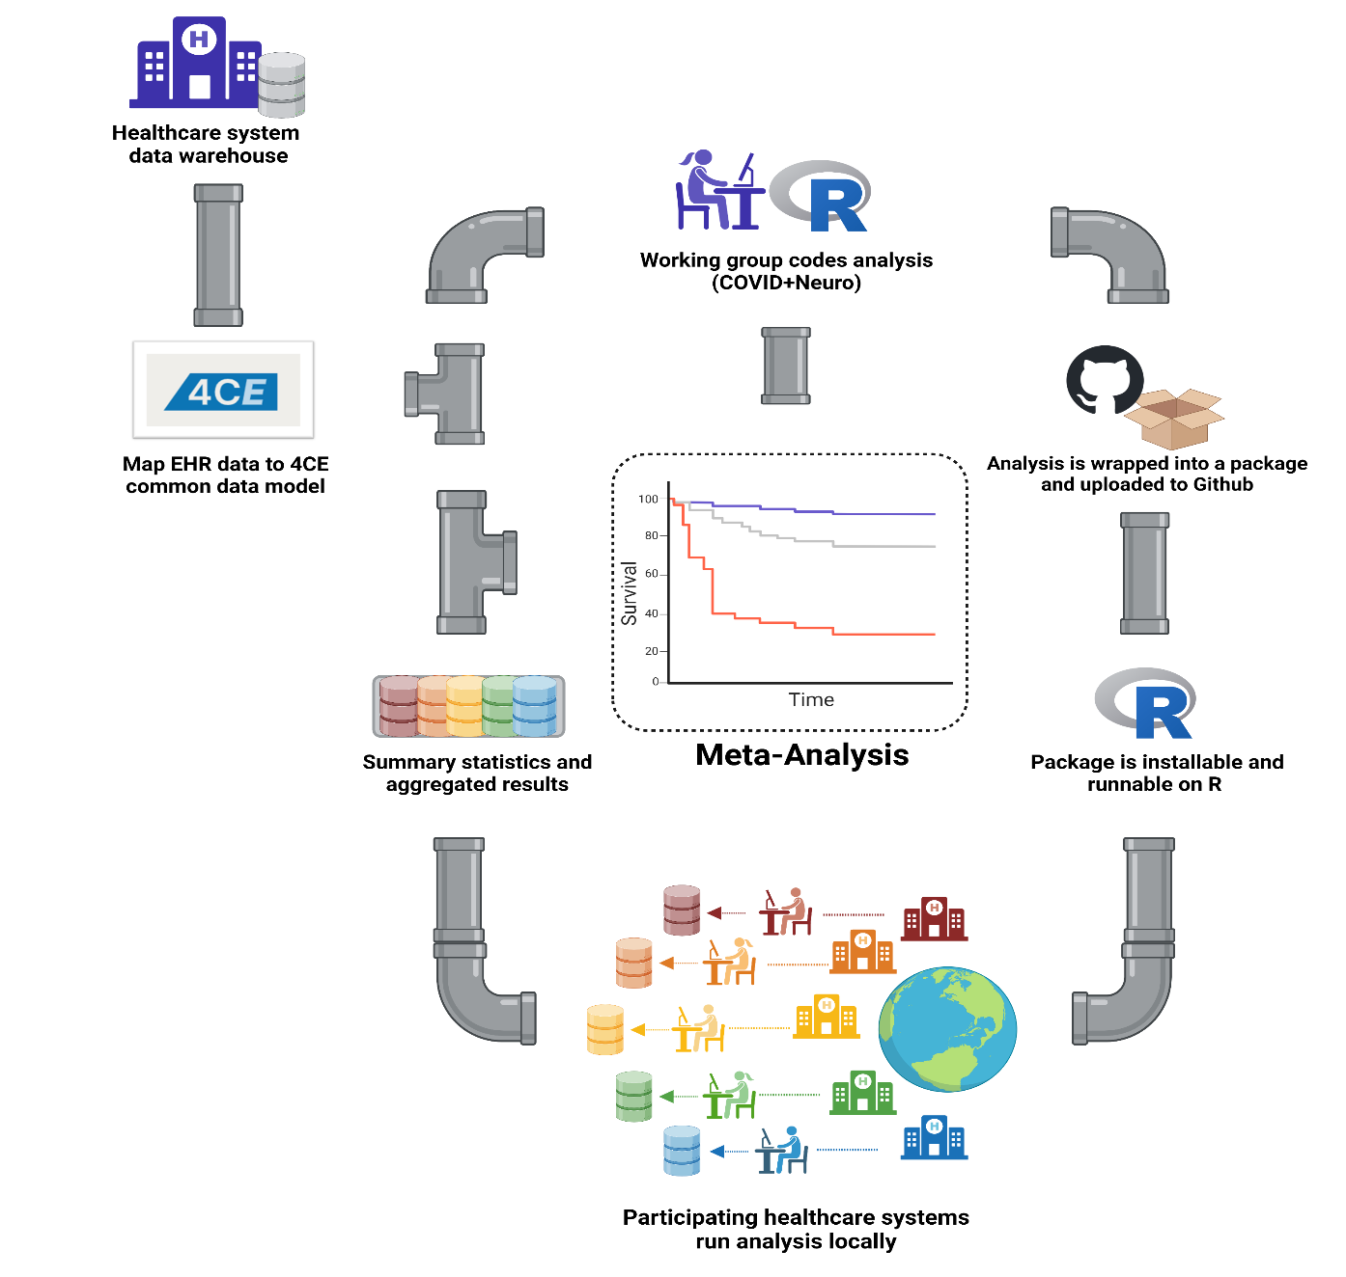
Pipeline for Federated COVID-19 Research
R license: https://www.r-project.org/Licenses/GPL-2

Slide 16
What do you think are some benefits of 4CE / federated learning approaches?
Notes:
So, the previous section slides were rhetorical questions – but this one I’d love to hear other people’s thoughts on

Slide 17
Benefits of 4CE / Federated Learning
Participating healthcare systems curate their data into 4CE Common Data Model -> standardization of data across healthcare systems
Curated dataset can support endeavors into multiple areas of research (e.g., neurology, pediatrics, computational phenotyping, nephrology)
Patient data does not leave the institution
Healthcare systems stay close to the data
Help allow for quick identification and resolution of QC issues

Slide 18
Part II
Clinical outcomes of hospitalized COVID-19 patients with neurological manifestations: a multinational study

Slide 19
Introduction
Studies have reported that COVID-19 patients with concurrent or new onset neurological manifestations are at an increased risk for prolonged hospital stay, disease severity, and mortality
Pre-existing comorbidities have also been associated with the manifestation of neurologic illness and poor health outcomes in COVID-19 patients
Mixed findings regarding risk and time of poor health outcomes:
Differences in study design (CNS vs PNS conditions)
Small sample size/single-centered studies
Non-diverse geographic locations
The disease trajectory and poor health outcomes in COVID-Neurological populations is still not fully understood

Slide 20
Objective
Leverage data from the 4CE Consortium to evaluate the risk of adverse clinical outcomes (e.g. longer hospital stay and mortality) in hospitalized COVID-19 patients with concurrent neurological manifestations.

Slide 21
Methods

Slide 22
Data Collection
Leveraged a unique dataset from the 4CE: large, multinational, and geographically diverse dataset of hospitalized COVID-19 patients
Our study includes 106,229 hospitalized patients from 21 healthcare systems from 6 countries (United States, France, Italy, Spain, United Kingdom, Germany, and Singapore)
Patients were stratified into 3 groups:
NNC: Non-neurological condition
CNS: Central nervous system condition
PNS: Peripheral nervous system condition

Slide 23
Data Collection – ICD Codes
CNS | PNS
Blindness and low vision | Disturbances of smell and taste
Cerebrovascular diseases | Inflammatory polyneuropathy
Cognitive functions and awareness | Myopathies
Disorders of the brain | Myositis
Dizziness and giddiness
Encephalitis, myelitis and encephalomyelitis
Epilepsy and recurrent seizures
Headache syndromes
Intracerebral hemorrhage (non-traumatic)
Intracranial hemorrhage (non-traumatic)
Lack of coordination
Meningitis
Psychosis
Subarachnoid hemorrhage (non-traumatic)
Transient cerebral ischemic attacks and related syndromes
Vascular syndromes of brain in cerebrovascular disease

Slide 24
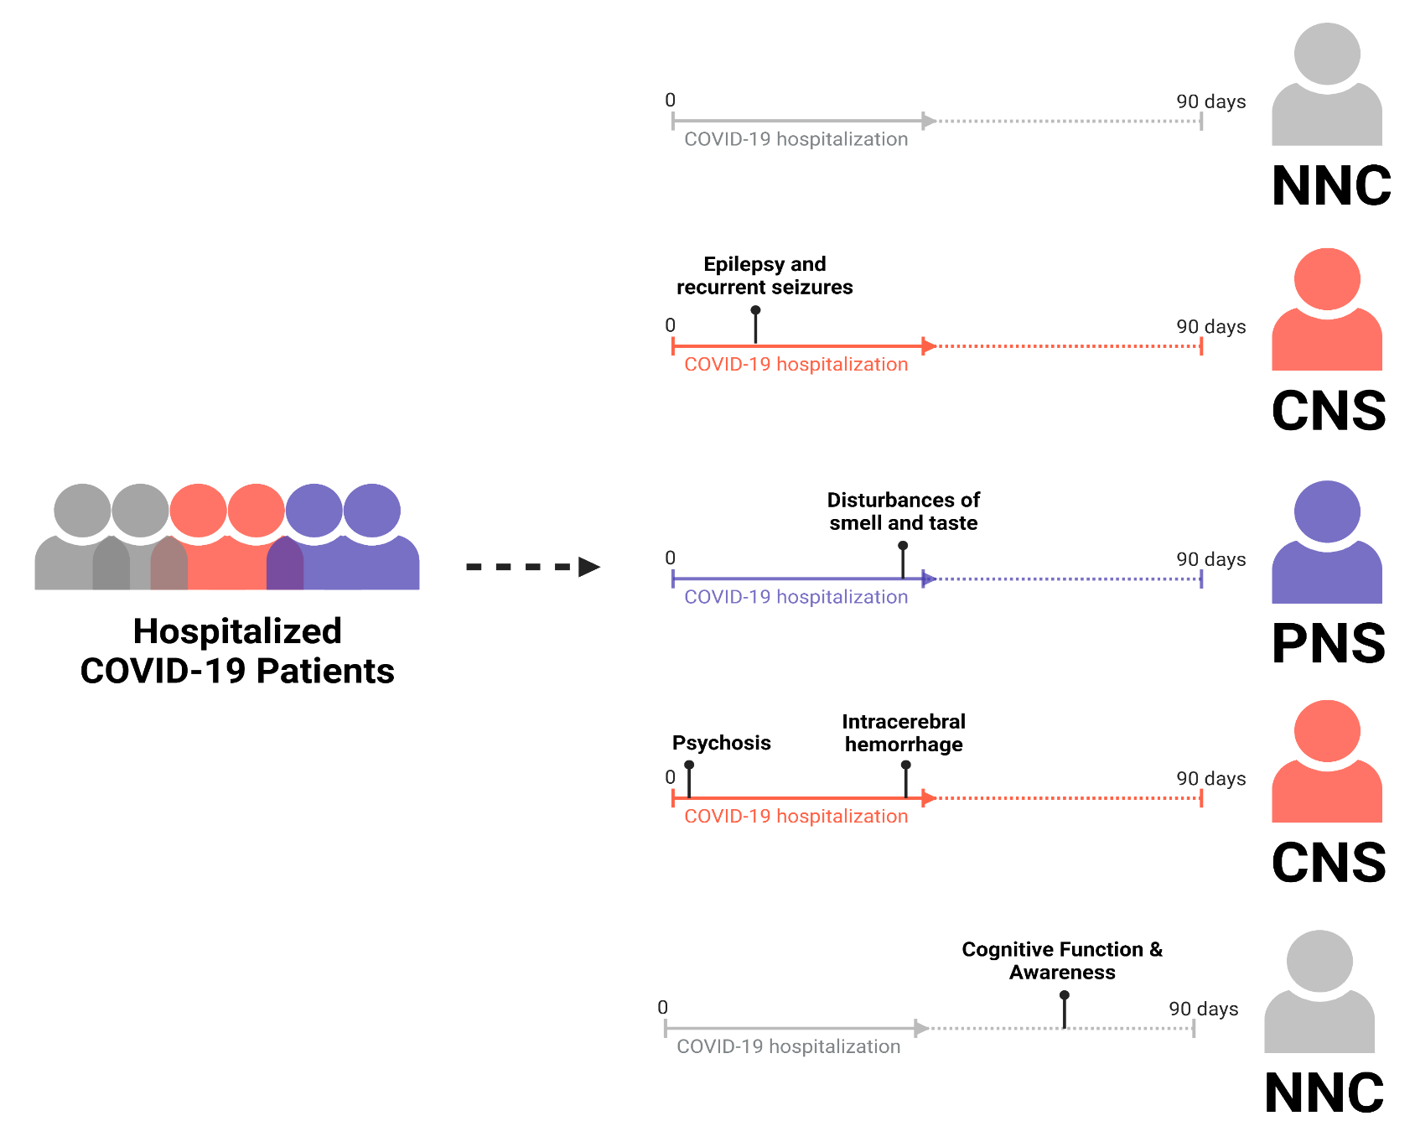
Data Collection

Slide 25
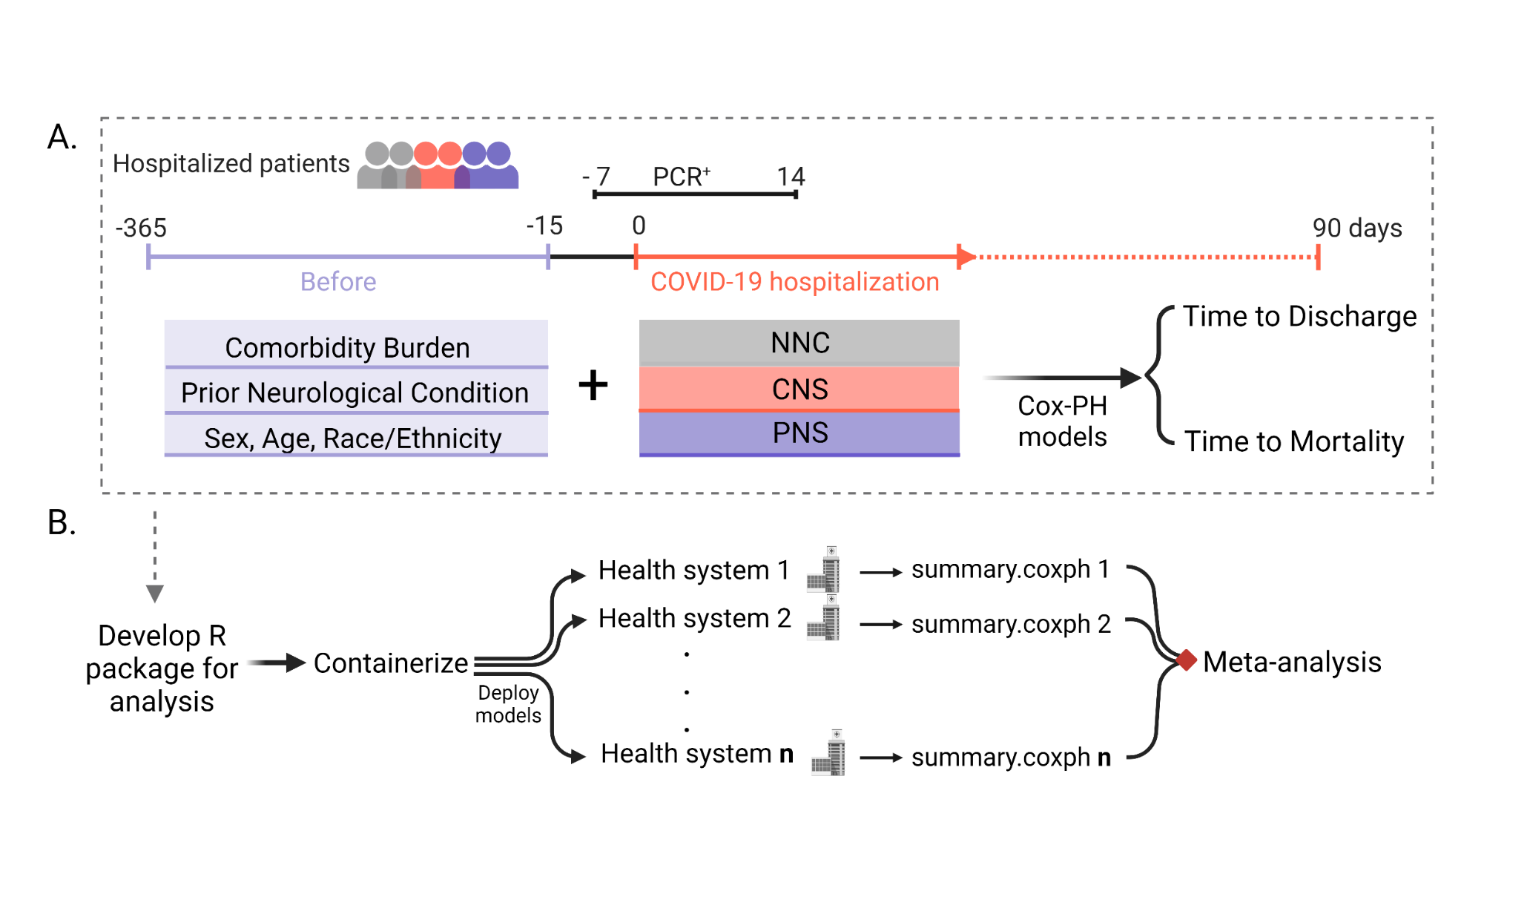
Study Design: Federated Network Approach

Slide 26
Federated Learning Approach: Random-Effects Meta-Analysis
Rather than the ML approach by Vaid et al, our study leveraged a random-effects meta-analysis to analyze results across healthcare systems

Slide 27
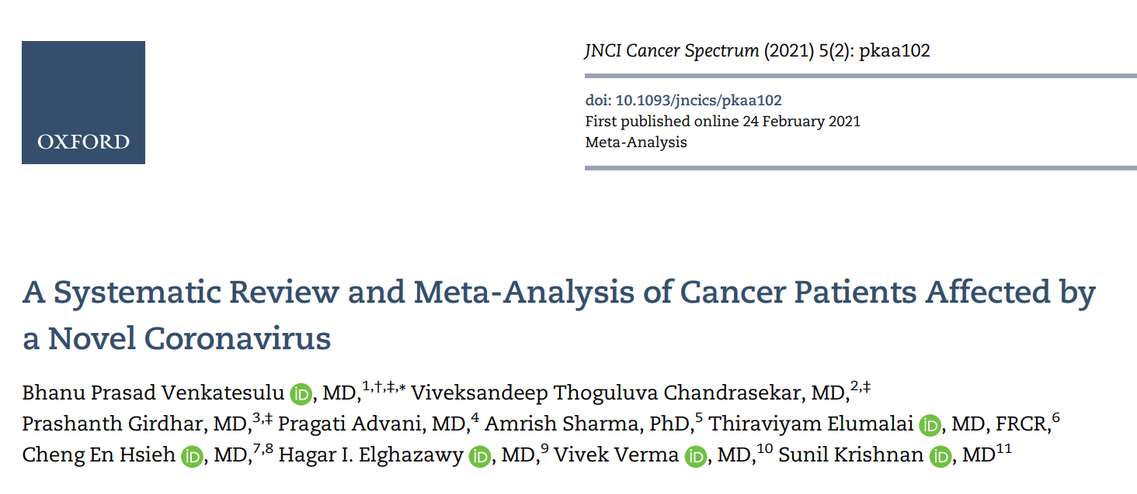
Federated Learning Approach: Random-Effects Meta-Analysis

Slide 28
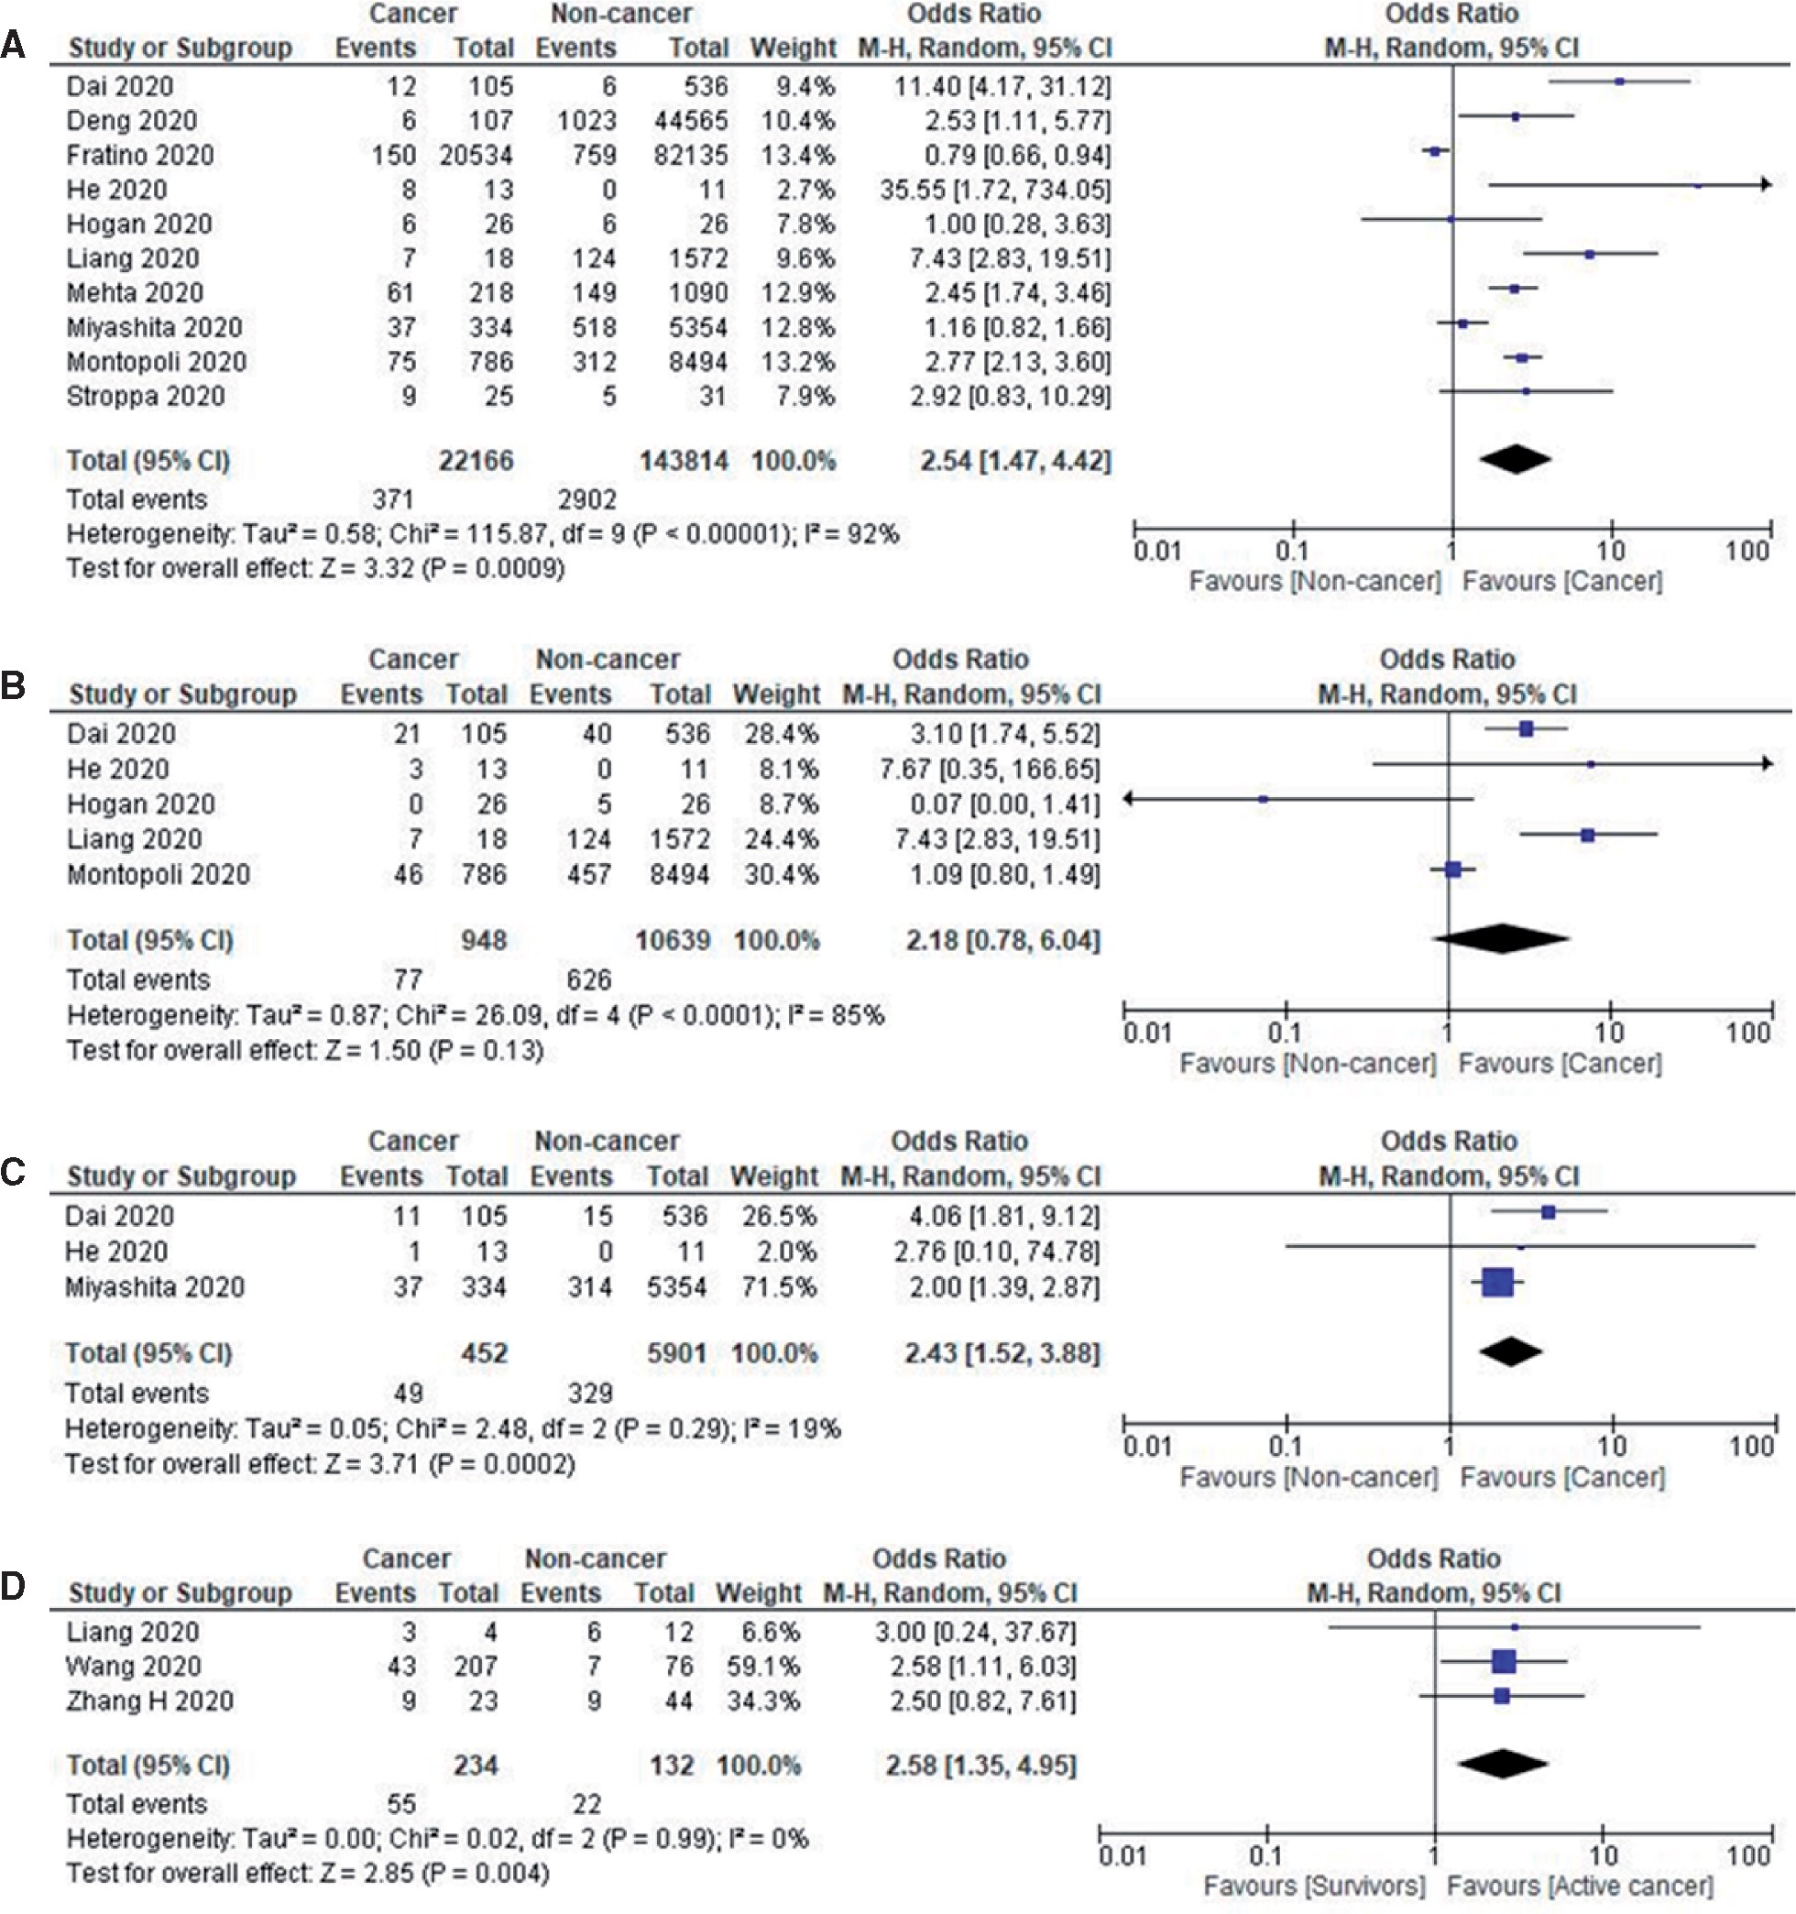
Introduction to Meta-analysis
Mortality
Notes:
Prognosis of patients with COVID-19. A) Forest plot of pooled in-hospital all-cause mortality rates between cancer patients and noncancer patients. B) Forest plot of intensive care unit admission rates between cancer patients and noncancer patients. C) Forest plot of intubation rates between cancer patients and noncancer patients. D) Forest plot of severe disease between active cancer patients and cancer survivors. Odds ratio calculated using the Mantel-Haenszel random-effects model and P value from the z test to examine whether the pooled estimate of effect is statistically significant. CI = confidence interval; M-H = Mantel-Haenszel Test.

Slide 29
Federated Learning Approach: Random-Effects Meta-Analysis
Meta-analysis allow us to evaluate the local effect size of each participating healthcare system and the overall pooled (or global!) effect size
Random-effects meta-analysis allows us to control for the effect of heterogeneity between each healthcare system
Population differences (i.e., demographics – race, ethnicity, socioeconomic factors)
Practice differences
Vaccination availability
Inverse of the variance is used to weight each study – this allows us to calculate the pooled effect size while accounting for heterogeneity between healthcare systems

Slide 30
Results

Slide 31
Demographics and clinical characteristics
Population | Total N | NNC | CNS | PNS
Adult | 104,031 | 86,321 (83%) | 14,938 (14%) | 2,772 (3%)
Pediatric | 2,198 | 2,019 (92%) | 163 (7%) | 16 (0.7%)
All | 106,229 | 88,340 | 15,101 | 2,788
*Note: Due to low frequency of neurological disease and incidence in pediatric patients, only adult patients were evaluated in our main analyses

Slide 32
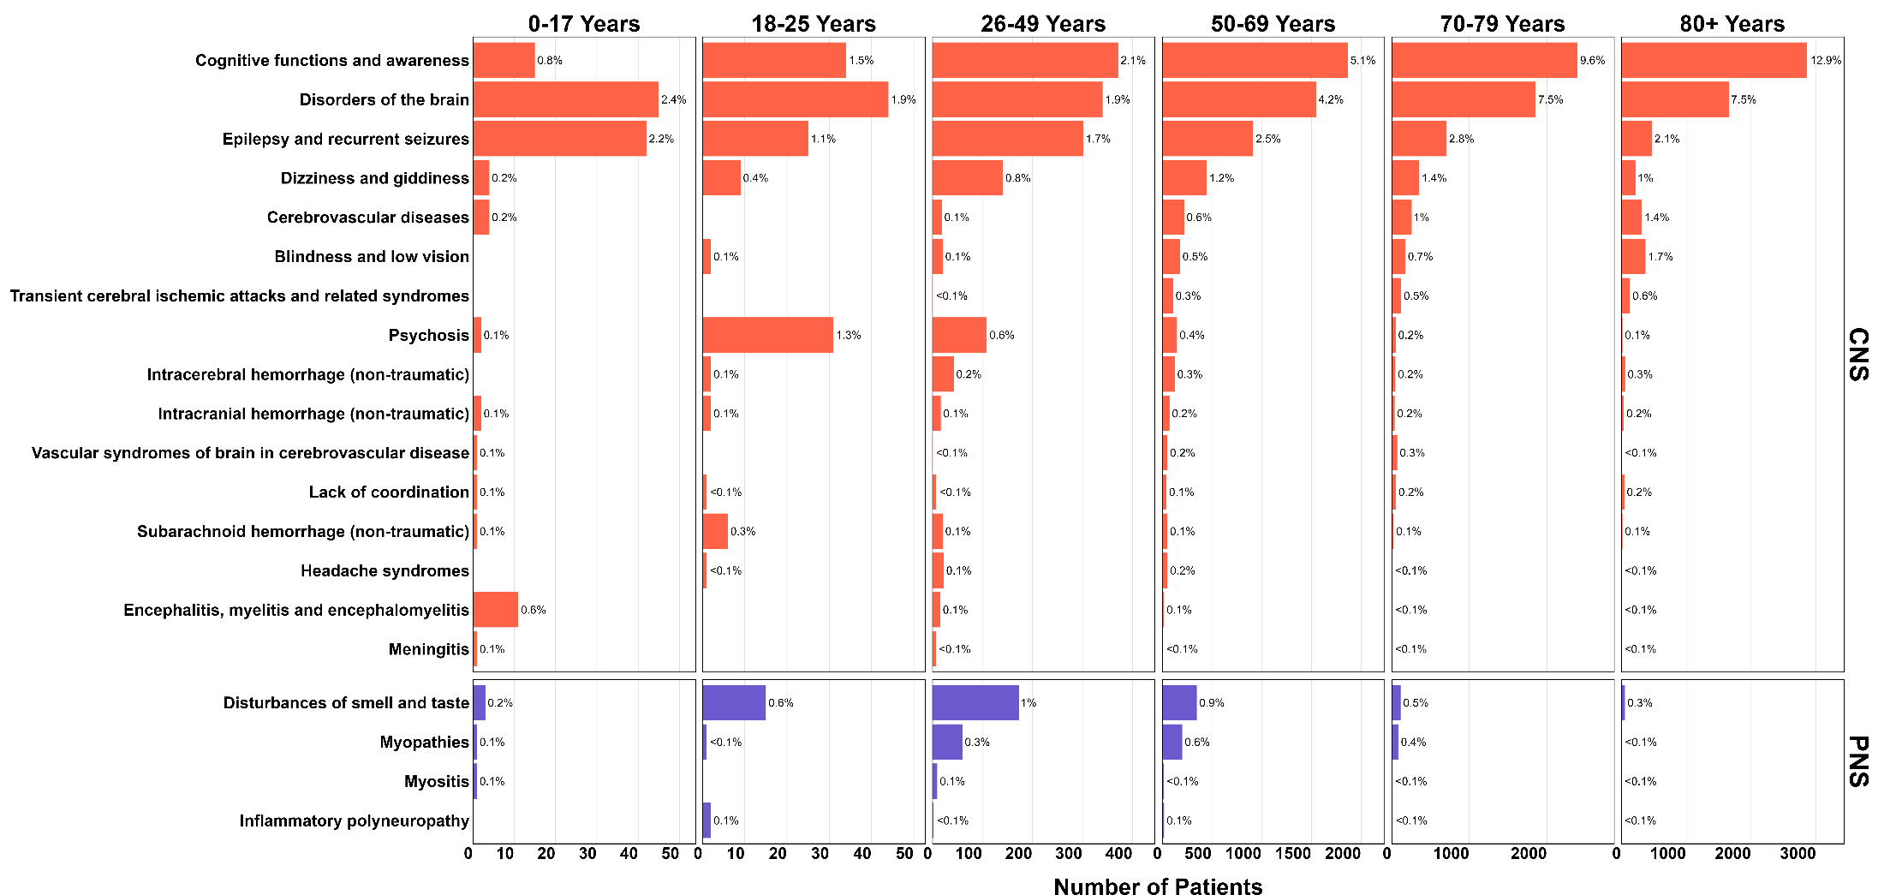
Frequency of neurological diagnosis by age group
Notes:
*disorders of the brain = Postviral fatigue syndrome, encephalopathy, edema,

Slide 33
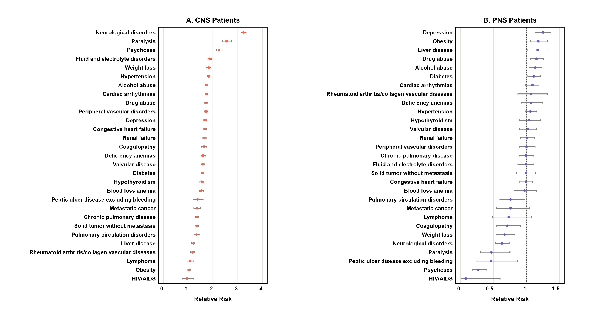
Relative risk of neurological diagnosis in Adults

Slide 34
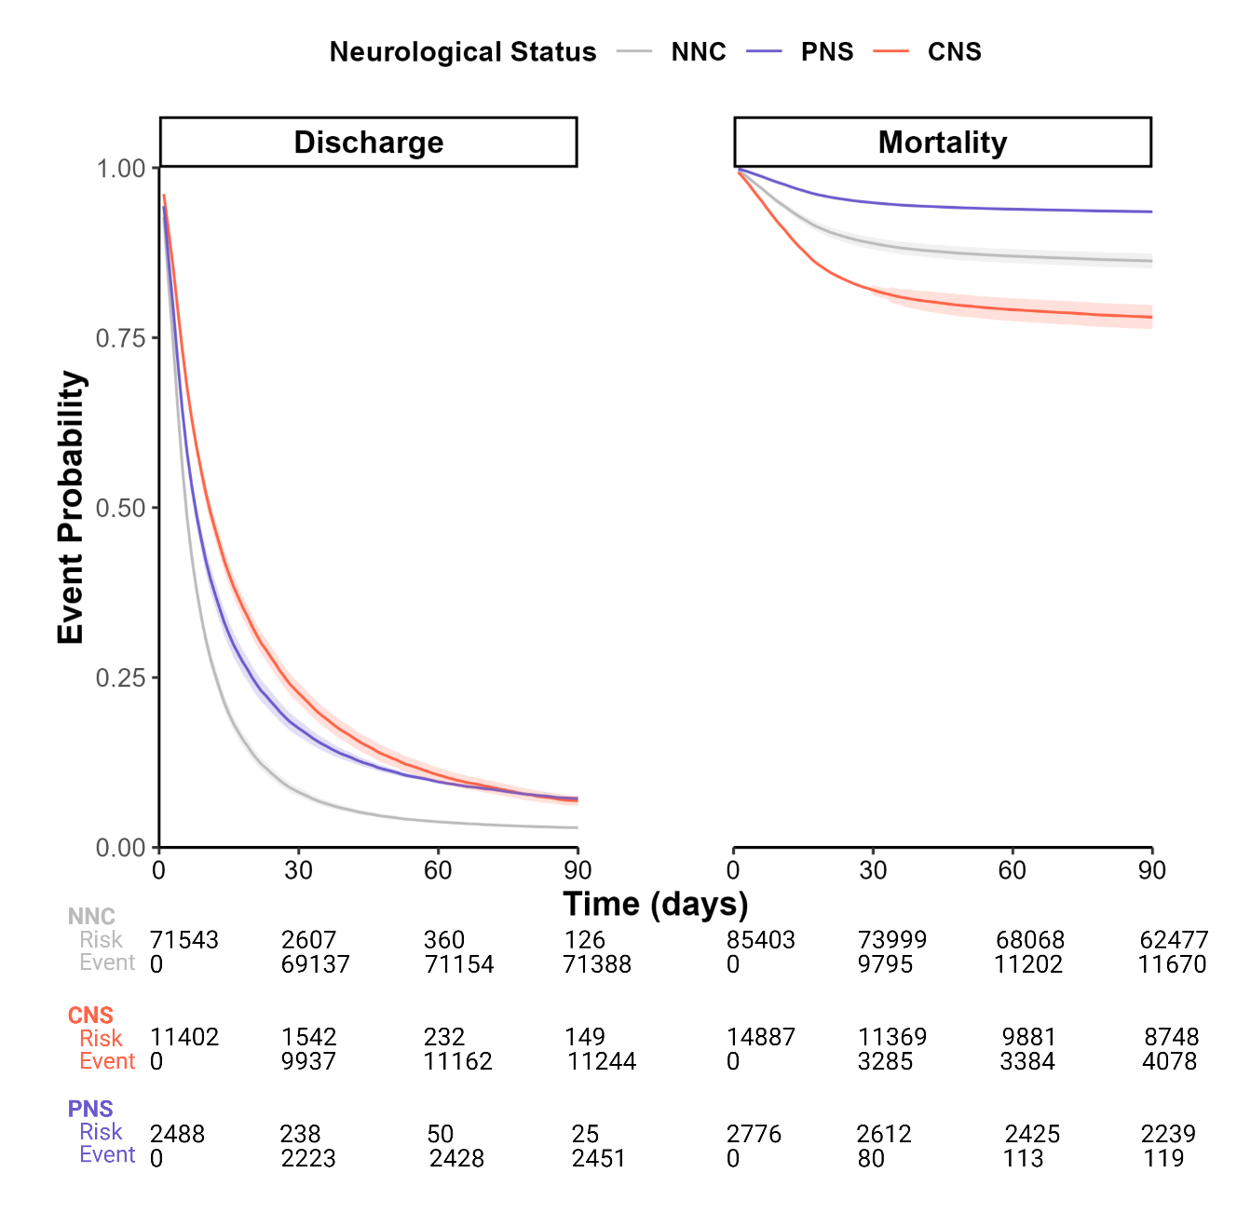
Covariate-Adjusted Survival Analysis in Adult Patients

Slide 35
Meta-Analysis: Cox-Proportional Hazards Model
Analysis | Neuro Status | Hazard Ratio 95% CI | P-value
Discharge | CNS | 0.54 (0.48, 0.6) | < .001*
 | PNS | 0.7 (0.6, 0.82) | < .001*
Mortality | CNS | 1.78 (1.5, 2.11) | < .001*
 | PNS | 0.46 (0.38, 0.56) | < .001*
Adult patients with CNS and PNS conditions had a decreased risk of discharge (i.e. longer hospital stay)
Patients with CNS conditions had an increased risk of mortality
Patients with PNS conditions had a decreased risk of mortality
Notes:
Our survival results were also corroborated by our Cox-proportional hazards models which allowed us to compute the hazard ratio for each event
CNS and PNS patients were both found to have a decreased risk of discharge (it’s a bit unintuitive, but a decreased risk can be likened to a longer hospital stay (these patients are less likely to be discharged) compared ot the non-neurological cohort
We also see that CNS patients had an increased risk of mortality, whereas PNS patients had a decreased risk
PNS results were surprising at first, but upon discussion with collaborators and consultation with the literature, our results may be a consequence of affirmation bias and hospital dynamics,. For example, we previously mentioned that the most frequently diagnoses PNS conditions seen included disturbances of smell and taste and myopathies. Patients who only have these diagnoses may be likely to be less severe, and also capable of reporting these symptoms, unlike more severe patients in our CNS cohort who may be unable to communicate after suffering seizures/strokes.

Slide 36
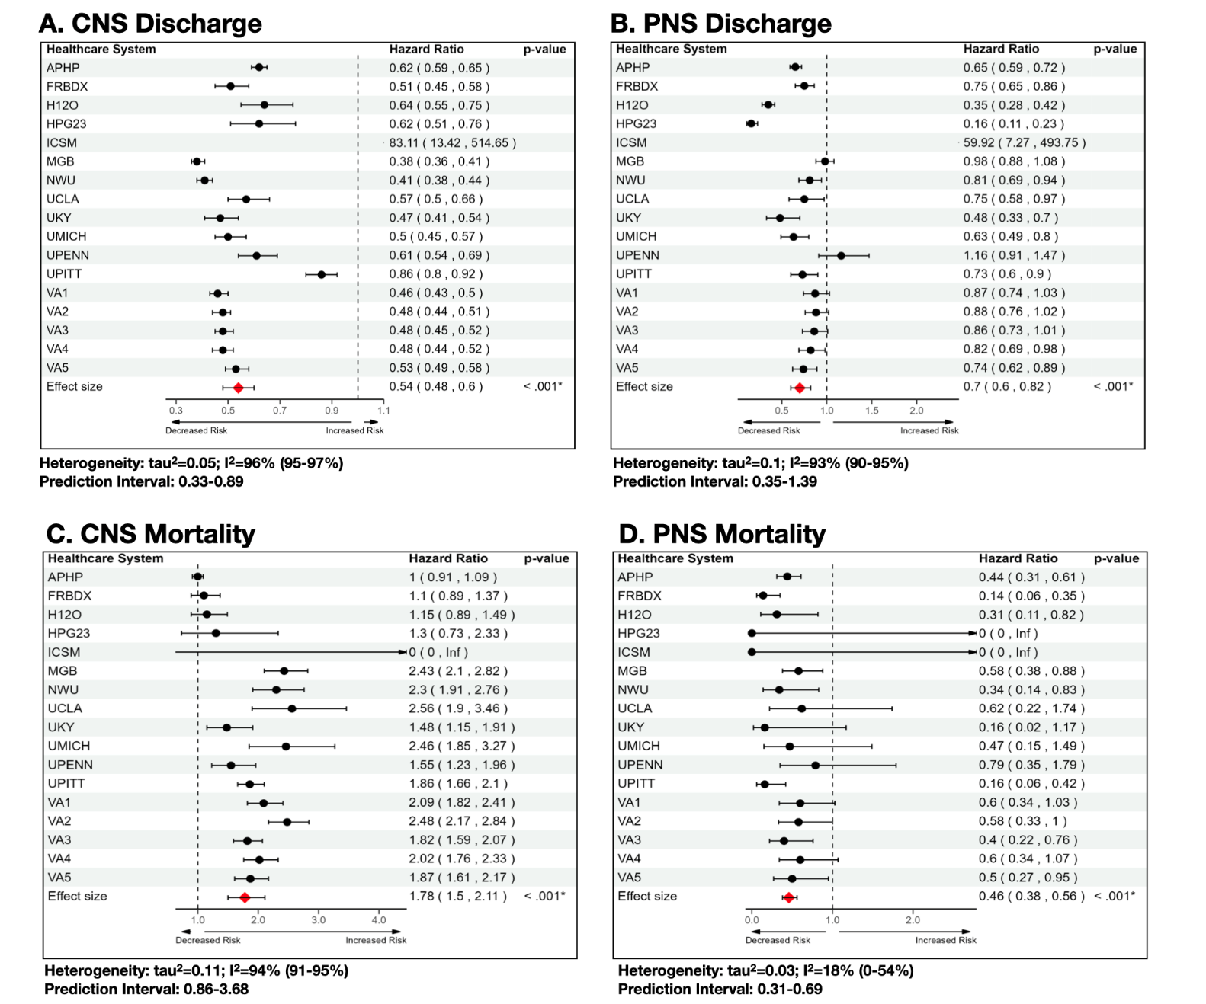
Results by Healthcare System

Slide 37
Conclusions

Slide 38
Findings
Demonstrated an approach for using federated learning on a large, multinational, and geographically diverse dataset to more definitively evaluate the association between COVID-19 infection and neurological illnesses
Our approach allowed us to evaluate the risk of poor disease outcomes in COVID-19 patients at the local healthcare system level, and globally
Our multinational study allows us to better generalize the risk of poor health outcomes in patients with COVID-19 and concurrent neurological manifestations

Slide 39
Acknowledgements and many thanks to:
Co-first authors:
Meghan R Hutch BS
Jiyeon Son MD
Trang T Le PhD
Chuan Hong PhD
Xuan Wang PhD
Zahra Shakeri Hossein Abad PhD
Co-senior authors:
Shyam Visweswaran MD, PhD
Tianxi Cai ScD
Yuan Luo PhD
Zongqi Xia MD, PhD
Michele Morris BA
Alba Gutiérrez-Sacristán PhD
Jeffrey G Klann MEng, PhD
Anastasia Spiridou PhD
Riccardo Bellazzi MS, PhD
Vincent Benoit PhD
Clara-Lea Bonzel MSc
William A Bryant PhD
Kelly Cho PhD, MPH
Priyam Das PhD
David A Hanauer MD, MS
Darren W Henderson BS
Yuk-Lam Ho MPH
Ne Hooi Will Loh MBBS
Adeline Makoudjou MD
Alberto Malovini PhD
Bertrand Moal MD, PhD
Danielle L Mowery PhD
Malarkodi Jebathilagam Samayamuthu MD
Fernando J Sanz Vidorreta BS
Emily R Schriver MS
Petra Schubert MPH
Jeffery Talbert PhD
Amelia LM Tan BSc, PhD
Byorn W.L. Tan MBBS
Bryce W.Q. Tan MBBS
Valentina Tibollo MS
William Yuan PhD
Paul Avillach MD, PhD
Nils Gehlenborg PhD
Gilbert S Omenn MD, PhD
Margaret Vella, BS
The Consortium for Clinical Characterization of COVID-19 by EHR (4CE)
Figures created with BioRender.com

Slide 40
Conclusions

Slide 41
Conclusion
Provide overview of federated learning and its advantages for studying EHR data
Reviewed an example of a 4CE COVID-19 Consortium study that leveraged a federated approach for evaluating neurological manifestations during hospitalization
Provided brief introduction to random-effects meta-analysis
https://bookdown.org/MathiasHarrer/Doing_Meta_Analysis_in_R/
Happy to provide extra resources regarding 4CE Consortium, literature/sample code for random-effects meta-analyses, or anything else ☺ meghan.hutch@northwestern.edu

Slide 42
Discussion – thoughts, comments, questions? - Could you apply Federated Learning to your own research?

